Slide 1
CS595 Paper Presentation: UniFuzz: A Holistic and Pragmatic Metrics-Driven Platform for Evaluating Fuzzers
Yuanzhou Yang
11/16/2020
Notes:
Hi my name is Yuanzhou Yang and I will present the paper UniFuzz: A Holistic and Pragmatic Metrics-Driven Platform for Evaluating Fuzzers.

Slide 2
Basic Information
Authors
Yuwei Li, Shouling Ji, Yuan Chen, Sizhuang Liang, Wei-Han Lee, Yueyao Chen, Chenyang Lyu, Chunming Wu, Raheem Beyah, Peng Cheng, Kangjie Lu, and Ting Wang
Institute
Zhejiang University, Zhejiang University NGICS Platform, Zhejiang Lab, Georgia Institute of Technology, IBM Research, University of Minnesota, Pennsylvania State University
Notes:
First, here’s some basic information about this paper. It is written by Yuwei Li, Shouling Ji, Yuan Chen, Sizhuang Liang, Wei-Han Lee, Yueyao Chen, Chenyang Lyu, Chunming Wu, Raheem Beyah, Peng Cheng, Kangjie Lu, and Ting Wang. And the institute participitate in ths paper includes Zhejiang University, Zhejiang University NGICS Platform, Zhejiang Lab, Georgia Institute of Technology, IBM Research, University of Minnesota and Pennsylvania State University

Slide 3
Content
Designed UniFuzz, an open-source and metric-driven platform for assessing fuzzers in a comprehensive and quantitative manner.
Using the UniFuzz to conduct extensive experiments on 8 prominent coverage-based fuzzers and gain important insights and findings for future fuzzing research.
Notes:
So, what’s this paper about? First, they have designed a metric-driven platform named unifuzz, this platform is used for assessing fuzzers in a comprehensive and quantitative manner, it is open source. Then, they used this unifuzz to evaluated 8 fuzzers and have gained some findings for future fuzzing research.

Slide 4
Motivation
How do these fuzzers perform in practice?
Usability issues of existing fuzzers.
How to compare different fuzzers under a fair and comprehensive set of performance metrics?
Lack of pragmatic real-world benchmark programs.
Lack of proper and comprehensive performance metrics.
Which fuzzing primitives or techniques are promising and should be promoted?
Notes:
Why they want to do it? There are three questions that the author want to answer. The first is how do these fuzzers perform in practice? Some fuzzers have some Usability issues, some fuzzers are not work properly as their authors claim. The second question is how to compare different fuzzers under a fair and comprehensive set of performance metrics? There are still questions about Which banchmark program should be used to test the fuzzers and which performance metrics should be used for comparison. The last question is Which fuzzing primitives or techniques are promising and should be promoted? Is there any fuzzers always be better than others and why they are better?

Slide 5
Contributions
Designed and implemented UniFuzz, the first opensource platform for evaluating fuzzers in a comprehensive and quantitative manner.
Conducted extensive experiments to compare eight prominent coverage-based fuzzers.
By analyzing the evaluation results from the UniFuzz, the authors have found previously unaccounted factors that can significantly affect the performance of fuzzers, e.g., instrumentation methods and crash analysis tools.
Notes:
Here’s the contributions of this paper. First Designed and implemented UniFuzz, the first opensource platform for evaluating fuzzers in a comprehensive and quantitative manner. Then they Conducted extensive experiments to compare eight prominent coverage-based fuzzers. The last By analyzing the evaluation results from the UniFuzz, the authors have found previously unaccounted factors that can significantly affect the performance of fuzzers, e.g., instrumentation methods and crash analysis tools.

Slide 6
Technique (Design of UniFuzz)
Fuzzers
Incorporated 35 usable fuzzers.
Using Docker container to conducting experiments.
Pragmatic Benchmarks
20 real-world programs.
Triaging crashes into unique bugs.
Matching CVEs (Common Vulnerabilities and Exposures).
Notes:
The next is the detail about how did the authors achieve their goals.
For the design of Unifuzz, it have incororated 35 usable fuzzers, because they are too much, so I won’t present all their names here. the type of these fuzzers are diverse, including grammar-based, mutation-based, directed and coverage-based fuzzers. The authors also implement a Dockerfile for installing and using it conveniently in a Docker container. They choose to conduct fuzzing experiments in a Docker container for the three reasons. First, Docker is more convenient for resource allocation and isolation than physical machine, which can provide fair fuzzing evaluations. Second Docker is lighter-weight and costs less computing resources compare than virtual machine, so users are able to conduct more fuzzing experiments simultaneously when using Docker. Last, Docker can be operated and managed more conveniently.
For the pragmatic benchmarks. The first is the program selection. There are 20 real-world programs have been selected. The selected programs cover six functionality types including: image, audio, video, text, binary and network packet processing software. In addition, they cover various types of vulnerabilities including: overflow, memory allocation, memory leak, free error, float point exception, use-after-free, etc. The second is how to triaging the crashes into unique bugs. There are two approaches, one is based on analyzing the root cause of the bugs, and the other is based on analyzing the output results. Because the first one is hard to implement in practice, so this paper use the approach of analyzing the output results. They use a tool named Asan for output report produce and another tool GDB for a supplement. Third, for the matching of Common Vulnerabilities and Exposures, the authors have constructed a CVE keywords database that includes the key information of the CVEs related to the UNIFUZZ benchmark programs in order to reduce the human efforts and increase the efficiency..

Slide 7
Technique (Design of UniFuzz)
Performance Metrics:
Quantity of Unique Bugs.
Quality of Bugs.
Speed of Finding Bugs.
Stability of Finding Bugs.
Coverage.
Overhead.
Notes:
Then is the other part. The Performance Metrics selection. By systematically study the performance metrics of the existing fuzzing papers, the authors have classified the metrics into six categories: quantity of unique bugs, quality of bugs, speed of finding bugs, stability of finding bugs, coverage and overhead. Each category represents a property of a fuzzer‘s performance, and each property can be evaluated by many concrete metrics which are expandable.

Slide 8
Evaluations
Eight state-of-the-art coverage-based fuzzers from UniFuzz.
AFL , AFLFast , Angora , Honggfuzz , MOPT , QSYM , T-Fuzz and VUzzer64.
Programs
20 real-world programs and LAVA-M.
Initial Seeds
100 random seeds for each program and default seed of LAVA-M.
Environments
20 Intel Xeon E5-2650 v4 CPU cores with 2.20 GHz, 64-bit Ubuntu 16.04 LTS. One CPU core, 2 GB RAM, and 1 GB swap space for each fuzzer.
Notes:
After the design of Unifuzz have been determined, This paper have selected 8 fuzzers to do the evaluation.
There several reasons for selecting these fuzzers are as follows. First, they are state of art fuzzers at the time of writing this paper. Second, they are open-source. Third, the eight selected fuzzers have better scalability than others which can be used to test most of the programs. Fourth, as it is not appropriate to compare between fuzzers of different types, and these 8 fuzzers they are all coverage-based fuzzers to provide comparable evaluations.
For the programs, the authors leverage the 20 real-world programs provided by UNIFUZZ to evaluate the selected fuzzers. In addition, we also use LAVA-M to explore the gap between the synthetic and the real-world programs.
For the initial seeds. First, the authors collect some seeds with the corresponding file format from the Internet. Second, they have excluded the seeds which do not satisfy a fuzzer’s requirement, Because some fuzzers such as AFL requires the size of a seed be less than 1 MB). Then, for the rest ones, they randomly select 100 seeds for each program. For programs of LAVA-M, they use the default seed set provided by LAVA-M.

Slide 9
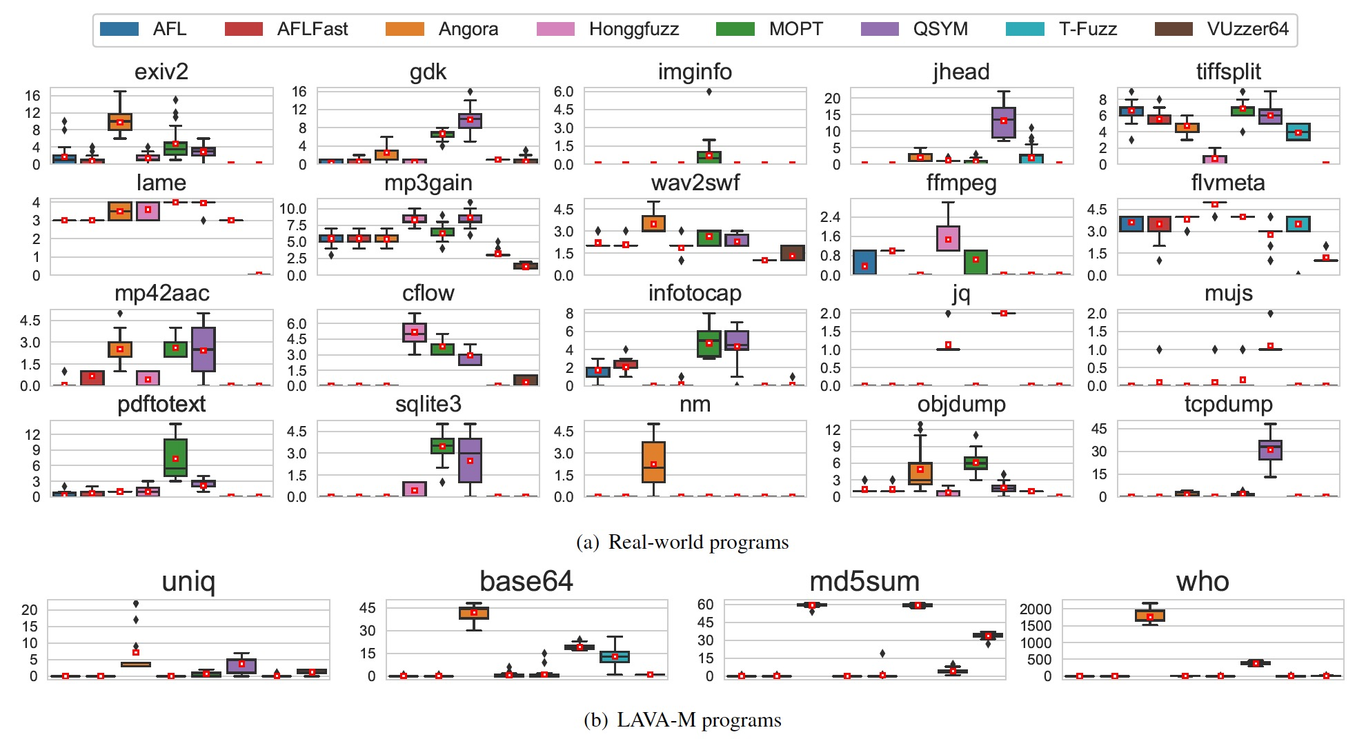
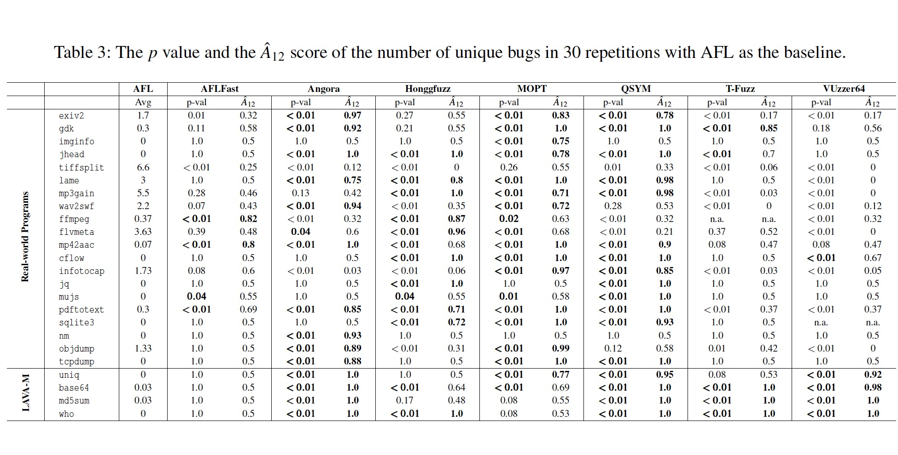
Evaluations
Quantity of unique bugs
Number of unique bugs
Statistical results
Notes:
Here’s the evaluation result. The first is quantity of unique bugs. This is the result of number of unique bugs detected by fuzzers.
(1) No fuzzer outperforms others on all the programs. (2) For the 20 realworld programs, QSYM performs the best on five programs (gdk, jhead, lame, mujs, tcpdump). Angora performs the best on three programs (exiv2, wav2swf, nm). Honggfuzz performs the best on three programs (ffmpeg, flvmeta, cflow). MOPT performs the best on three programs (imginfo, lame, pdftotext). AFL performs the best on only one program tiffsplit. AFLFast, T-Fuzz and VUzzer64 fail to achieve the best performance on any target program. (3) For the programs of LAVAM, Angora performs the best among the selected fuzzers, while QSYM only achieves similar performance as Angora on program md5sum.
For the two statistical results: p value and ˆA12 （a hat 12) score. The p value aims to quantify whether there is a significant difference two fuzzers. ˆA (a hat) 12 score is used to measure the probability that one fuzzer is better than the other according to all the repetitions. The authors use AFL as the baseline fuzzer p < 0.05 as an indicator that there exists a significant difference. For ˆA12 score, we consider ˆA12 >=0.71 as an indicator that there is a large effect size. From Table 3, there are following observations. (1) None of the remaining seven fuzzers outperforms AFL significantly on all the real-world programs, but Angora, QSYM and VUzzer64 that outperform AFL significantly on all four programs of LAVA-M. (2) Based on the results of p value, MOPT performs significantly better than AFL on 17 real-world programs, which is the most among the seven fuzzers. QSYM, Angora and Honggfuzz perform significantly better than AFL on 13, 11 and 11 real-world programs respectively. However, AFLFast only performs significantly better than AFL on 4 real-world programs. Even worse, T-Fuzz and VUzzer64 do not outperform AFL significantly on any real-world program. (3) Considering the ˆA12 score metric, the fuzzers have the similar performance compared with the p value metric. The fuzzers that have large effect size (ˆA12 0:71) all outperform significantly (p value < 0.05) than AFL, but not vice versa. For instance, AFLFast outperforms significantly than AFL on mujs (p = 0.04), but the effect size (ˆA12 = 0:55) is not large.

Slide 10
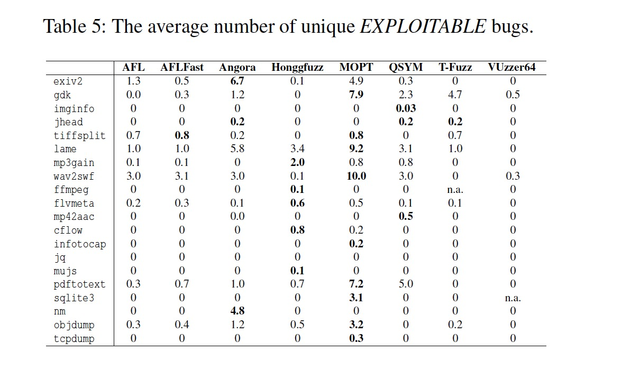
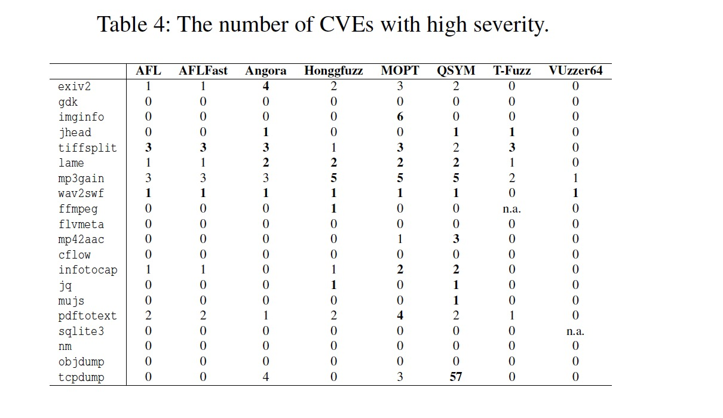
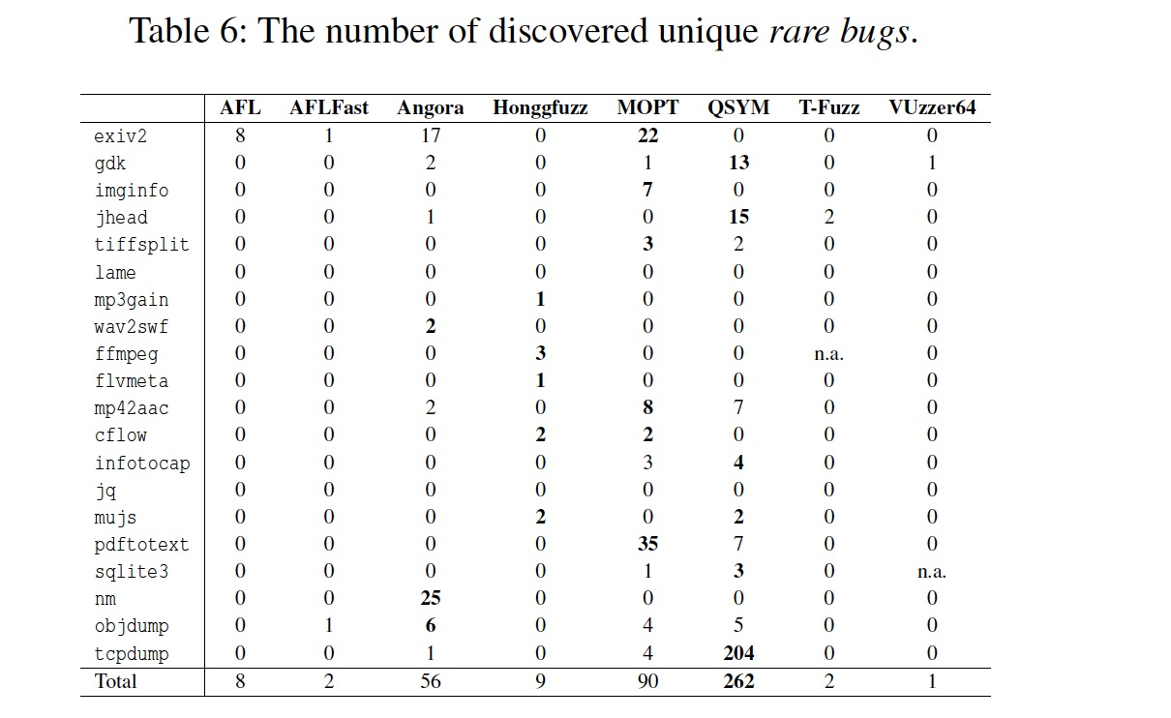
Evaluations
The quality of bugs
Severity of bugs
Rareness of bugs
Notes:
For the quality of bugs. CVE CVSS provides a numerical score for each CVE to quantify its severity. A CVE is considered as highly severe when the score is greater than or equal to 7.0. The authors used GDB extension Exploitable to assess the exploitability of a crash, which can be classified into four categories:
EXPLOITABLE, PROBABLY_EXPLOITABLE, PROBABLY_ NOT_EXPLOITABLE and UNKNOWN
As presented in Table 4, the fuzzers have preference on specific programs in discovering highly severe CVEs. For instance, QSYM discovers 57 highly severe CVEs on tcpdump, while Honggfuzz cannot discover any one. However, for ffmpeg, Honggfuzz can discover one highly severe CVE, while the remaining fuzzers (including QSYM) cannot find any one. Moreover, it is interesting to note that AFL and AFLFast are comparable with respect to the number of discovered highly severe CVEs on each program.
Table 5 presents the of unique bugs that are classified as EXPLOITABLE. As presented in Table 5, MOPT outperforms the other fuzzers on 9 programs in detecting EXPLOITABLE bugs. Angora, Honggfuzz and QSYM achieve the best performance on 3, 5 and 3 programs, respectively. Nevertheless, VUzzer64 does not perform well as it can only detect EXPLOITABLE bugs on 2 programs.
For the rare bugs, the authors defines a bug that can be found by only one fuzzer a rare bug7. Correspondingly, a fuzzer that can find more unique rare bugs is relatively more powerful. QSYM achieves the best performance by discovering 262 unique rare bugs. MOPT achieves the second best performance and discovers 90 unique rare bugs. Angora finds 56 unique rare bugs in total. Nevertheless, AFLFast only detects rare bugs on two programs. AFL, T-Fuzz and VUzzer64 only detect rare bugs on one program. It is worth noting that fuzzers also have preference on target programs in discovering rare bugs. For instance, QSYM discovers 204 unique rare bugs on tcpdump, while in comparison Angora only discovers one rare bug and the other fuzzers fail to find any rare bug. For nm, Angora can discover 25 unique rare bugs, while the remaining fuzzers including QSYM fail to discover any rare bug.

Slide 11
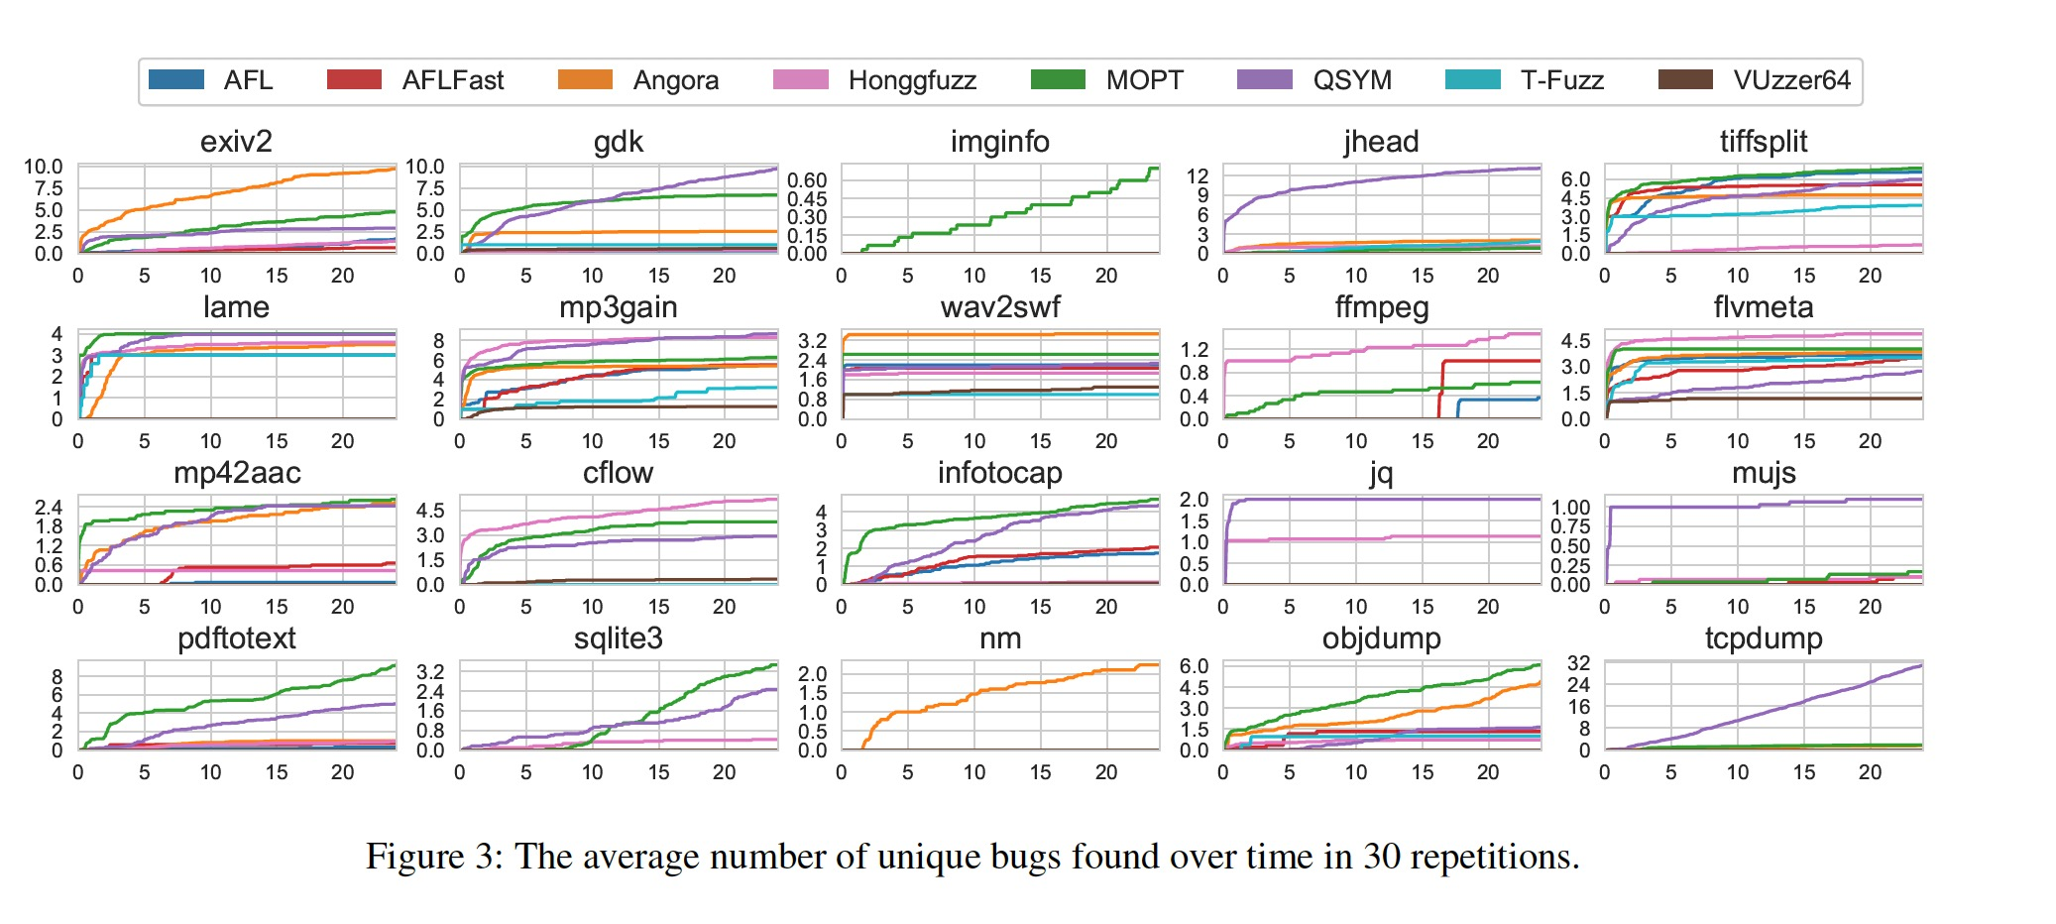
Evaluations
Speed of finding bugs
Notes:
Then is the speed of finding bugs. This figure presents the average number of unique bugs found over time in 30 repetitions
First, one intuitive observation is that no fuzzer wins the others on all the programs on this metric.
Second, the comparisons among fuzzers’ performance may get reverse over time. For instance, MOPT finds less unique bugs than QSYM on program sqlite3 in the early time, but it finds more unique bugs than QSYM after 10 hours.
Third, although some fuzzers find the similar number of unique bugs, their speeds of finding bugs are different. For instance, Angora, MOPT and QSYM find a similar number of unique bugs on program mp42aac (2.5, 2.6 and 2.4 unique bugs in average, respectively) within 24 hours, while MOPT finds the bugs more quickly than Angora and QSYM.
This observation also indicates the importance of the speed metric, as only leveraging the number of unique bugs may overlook the difference of fuzzers in speed.

Slide 12
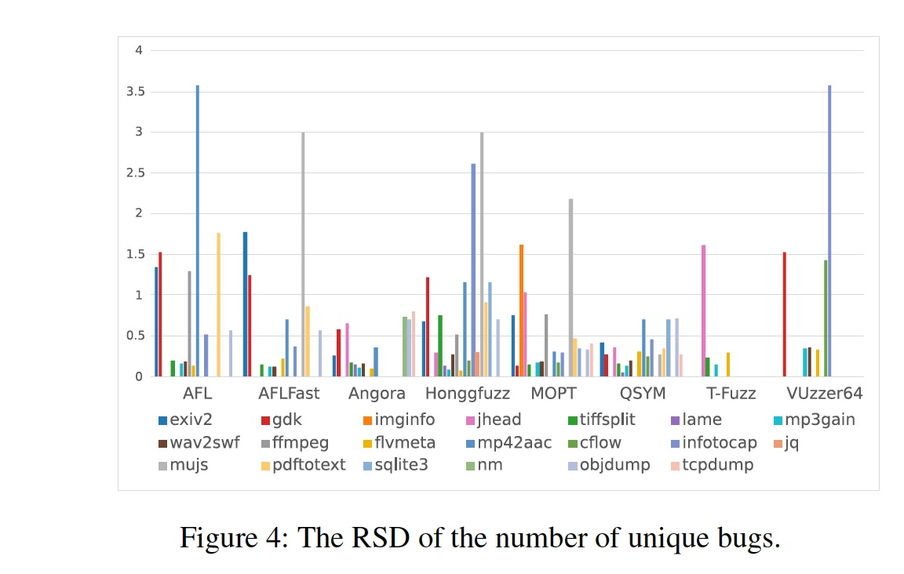
Evaluations
Stability of Finding Bugs
Notes:
Here is the Stability of Finding Bugs
Figure 4 presents the relative standard deviation (RSD) of the number of unique bugs in all the 30 repetitions, where a lower RSD represents better stability of a fuzzer. As depicted in Figure 4, first, all the fuzzers are not always stable in finding bugs, which reflects the randomness of fuzzing and the importance of repetitions. Second, among the seven fuzzers, Angora and T-Fuzz achieve lower RSD, while AFL and Honggfuzz achieve higher RSD. Third, the stability of
a fuzzer varies with different programs. For instance, AFL has better stability on several programs such as tiffsplit, mp3gain, as compared to that on mp42aac.

Slide 13
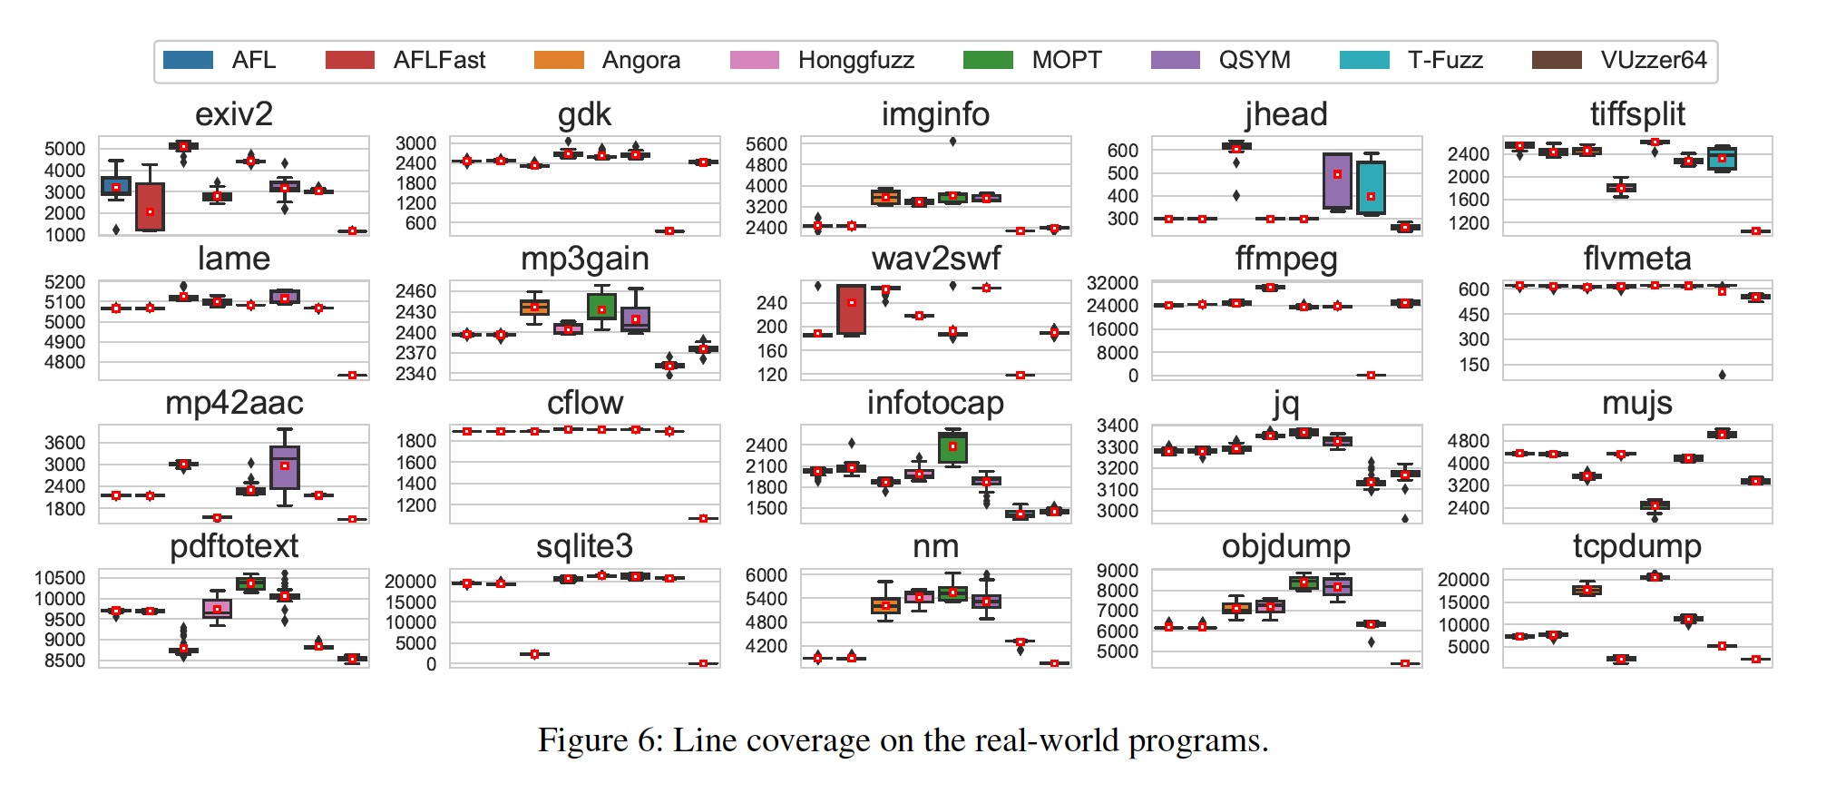
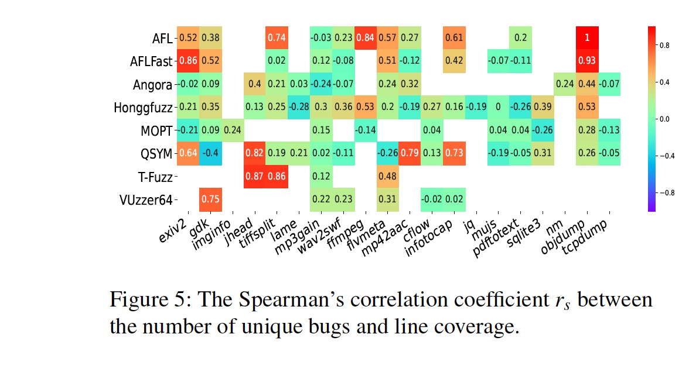
Evaluations
Coverage
Notes:
Then is the result of line coverage
Figure 6 shows the results of line coverage, from which we observe that no fuzzer stably achieves higher coverage than the others. By comparing
Figure 2(a) and Figure 6, we observe that higher coverage does not necessarily mean more unique bugs. For instance, MOPT achieves the highest coverage on tcpdump among all the fuzzers while QSYM discovers the most unique bugs on tcpdump. To further explore the relationship between the number of unique bugs and line coverage, we calculate the Spearman correlation coefficient rs between them, which is a non-parametric measure of correlation between two variables and rs 2 [􀀀1;+1]. A positive rs means that the two variables are positively correlated and vice versa. Figure 5 presents the value of rs between the number of unique bugs and line coverage, where we observe that most of them are less than 0:60, which means that the correlation between the number of unique bugs and the line coverage is not strong.

Slide 14
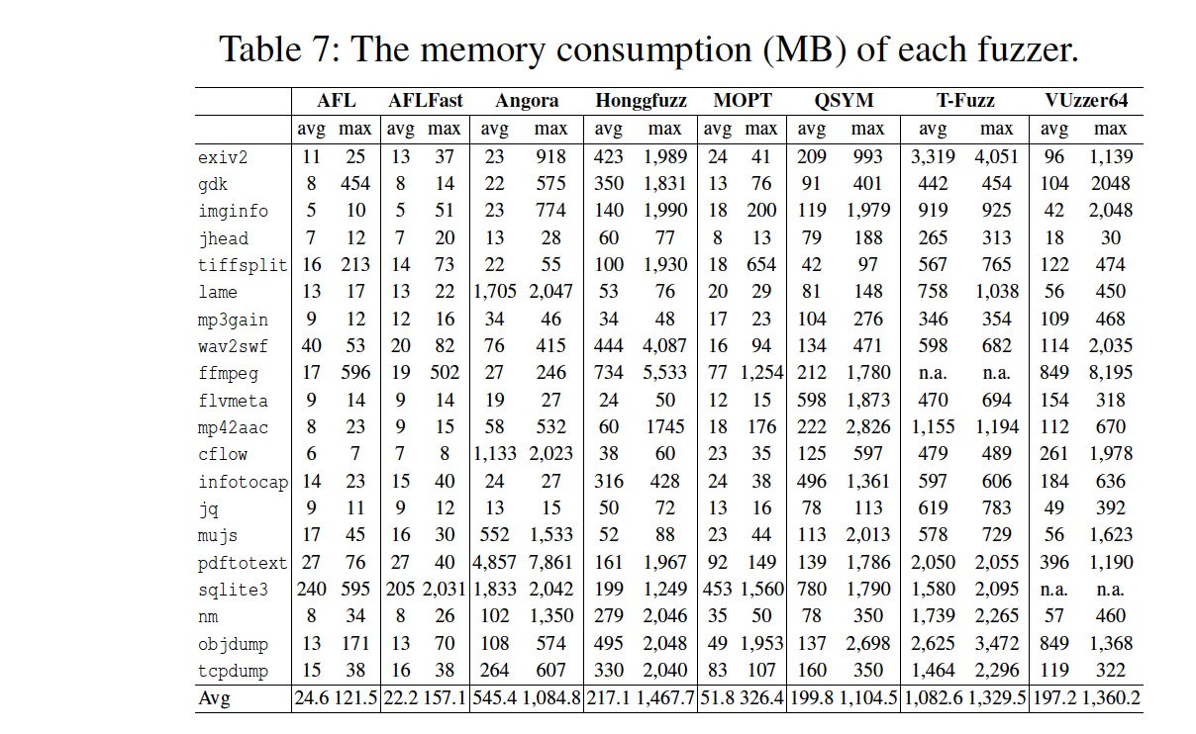
Evaluations
Overhead
Notes:
The last is the overhead
Table 7 shows the average and maximum memory consumption of each fuzzer, here’s the following observations.
(1) From a holistic aspect, AFL, AFLFast and MOPT consume less memory during fuzzing than the other fuzzers, with average memory consumption 24.6 MB, 22.2 MB and
51.8 MB respectively. And T-Fuzz consumes 1,082 MB memory during fuzzing, which is almost 50 times more than that of AFLFast and is the most among the fuzzers. (2) When fuzzing the same program, the memory consumption of different fuzzers varies significantly. For example, when fuzzing program exiv2, AFL uses no more than 25 MB memory, while in comparison, T-Fuzz uses about 4 GB memory. (3) For the same fuzzer, its memory consumption on various programs also differ greatly. For instance, Angora uses more than 7 GB memory when testing pdftotext while its memory consumption on the other programs is less than 2 GB.

Slide 15
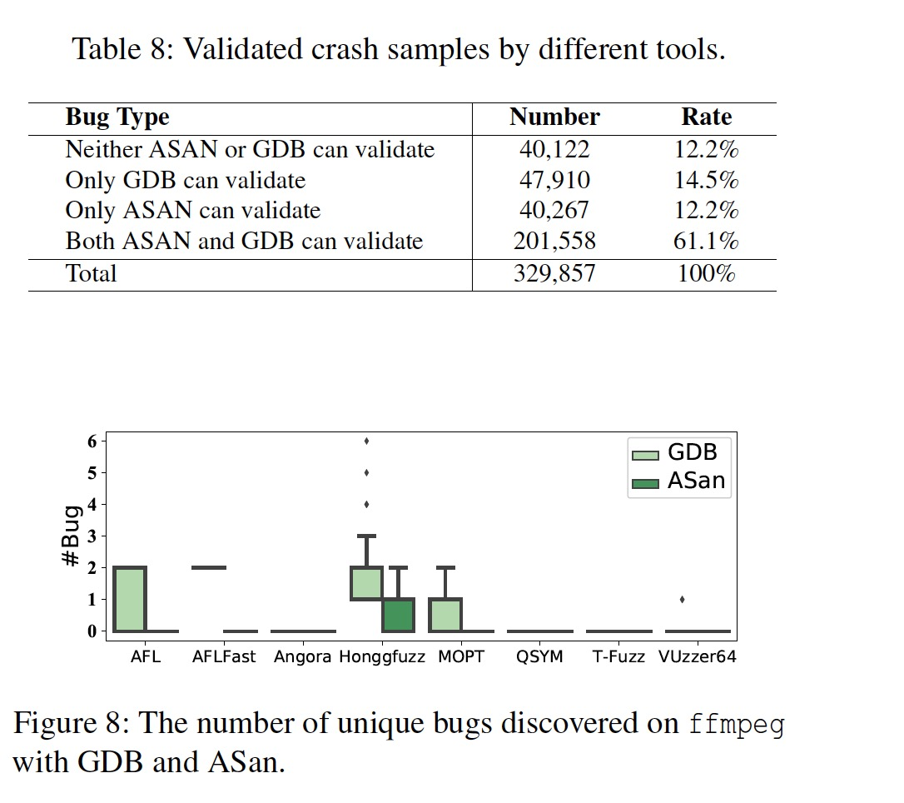
Further Analysis
Instrumentation Methods
Crash Analysis Tools
Notes:
Because all these metric did’t get a significant result, so the authour conduct evaluations to investigate the previously overlooked factors that may significantly affect a fuzzer’s performance, including instrumentation methods and crash analysis tools.
For the instrumentations By analyzing these bugs of infotocap, we find that they are related to the compilation methods. In this scenario, the failure for
Angora to discover these crash samples is due to its instrumentation method rather than its capability of discovering bugs.
For the crash analysis tools
Using one analysis tool singly may limit the number of detected bugs, which may further fail to provide comprehensive
evaluations on fuzzers.
As shown in Figure 8, the evaluation results are different when using different analysis tools. When using ASan, only Honggfuzz can discover bugs, while using GDB, AFL and AFLFast can also discover bugs.

Slide 16
Conclusion
No fuzzer always performs better than others.
Fuzzers’ performance on the synthetic benchmark programs may not be consistent with that on the real-world programs.
New factors such as instrumentation methods and crash analysis tools that can significantly affect the evaluation of fuzzers.
Notes:
Here’s the conclusions.
First, no fuzzer always performs better than others, revealing potential subjectivity and bias in the evaluations of existing fuzzing works. Second, the performance of fuzzers on the synthetic benchmark programs may not be consistent with that on the real-world programs, which confirms the importance of using pragmatic benchmark programs. Third, the performance of fuzzers varies with different performance metrics, which indicates that the fuzzers need to be evaluated with more comprehensive performance metrics for reliable assessments. In addition, we identify new factors such as instrumentation methods and crash analysis tools that can significantly affect the evaluation of fuzzers. We have made UNIFUZZ publicly available to facilitate future fuzzing research.

Slide 17
My thought
Fuzzers based on the random seeds. It is hard to evaluated it.
The metrics is fine.
Maybe use the same initial seeds would be fairer.
Notes:
The problem is about the evaluation and real-world performance.

Slide 18
Thank you!

